Slide 1

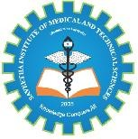
SMART DIGITAL INTERNSHIP AND SKILL TRACKING SYSTEM
SIMATS ENGINEERING
Saveetha Institute of Medical and Technical Sciences
Chennai-602105
CSA4302-INTERNET PROGRAMMING
Presented by:
G Bala Sri Yogitha (192411122)
T Pranavi (192411222)
C Rohitha (192411012)
Guided by
T Kosalairaman

Slide 2

PROBLEM STATEMENT
Manual internship record management is difficult.
Students struggle to track progress, skills, and certificates.
Faculty face challenges in monitoring and verifying internships.
Manual records can cause data loss, duplication, and errors.
A secure, centralized web-based system is needed.

Slide 3
OBJECTIVES
Develop a web-based system to manage student internship details.
Allow students to update their skills, certificates, and profiles.
Enable faculty to verify and monitor internship records. Reduce paperwork by storing all information digitally.
Track student internship progress and skill development.
Generate reports for students and faculty to improve internship management.

Slide 4
LITERATURE SURVEY
S.NO | YEAR | AUTHOR | TITLE | KEY FINDINGS
1 | 2026 | Harson Kapoh, Olga E. Melo & Anthon Arie Kimbal | Digitalization of the Internship Management System to Supports Independent Learning | Digital internship systems can simplify internship applications, placement, supervision and evaluation while reducing manual work.
2 | 2026 | Reza Safdari & Hamideh Ehtesham | The Essential Data Elements for Developing an Internship Monitoring System | Identified important data elements required for effective internship monitoring, student supervision and evaluation.
3 | 2025 | Hyrmet Mydyti & Andrew Ware | Integrating Intelligent Web Scraping Techniques in Internship Management Systems: Enhancing Internship Matching | Intelligent web scraping, machine learning and NLP can improve matching between student competencies, interests and available internship opportunities.
4 | 2025 | Valdez et al. | Employability Skills Perception of Employers and Student Interns | Found differences between skills expected by employers and skills perceived as important by students, highlighting the need for better skill-gap awareness.
5 | 2025 | Tecson et al. | Bridging the Gap: Aligning Internship Skills With Industry Demand | Emphasized the importance of aligning technical, soft and cognitive skills developed during internships with current industry requirements.

Slide 5
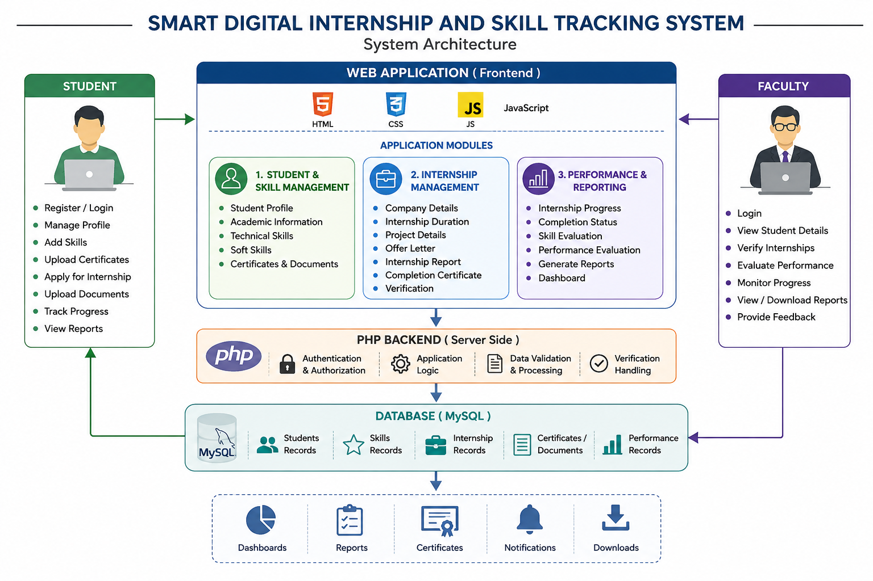
SYSTEM ARCHITECTURE

Slide 6
PROPOSED SOLUTION
Develop a centralized web-based internship management system.
Allow students to update internship details and skills.
Enable certificate uploads and verification.
Provide faculty with progress monitoring and reports.

Slide 7

FUTURE SCOPE
Add AI-based skill recommendations.
Integrate internship and job portals.
Provide automated certificate verification.
Develop a mobile application.
Generate performance reports and analytics.

Slide 8
REFRENCES
Fowler, M. (2004). UML distilled: A brief guide to the standard object modeling language (3rd ed.). Addison-Wesley.
Nixon, R. (2018). Learning PHP, MySQL & JavaScript: With jQuery, CSS & HTML5 (5th ed.). O’Reilly Media.
Pressman, R. S., & Maxim, B. R. (2015). Software engineering: A practitioner’s approach (8th ed.). McGraw-Hill Education.
Silberschatz, A., Galvin, P. B., & Gagne, G. (2018). Operating system concepts (10th ed.). Wiley.
Sommerville, I. (2016). Software engineering (10th ed.). Pearson.

Slide 9
THANK YOU

